Slide 1

Data Models
Jeffery S. Horsburgh
Hydroinformatics
Fall 2016
This work was funded by National Science Foundation Grants EPS 1135482 and EPS 1208732

Slide 2
Announcements
Assignment 2 – Due Thursday
Install MySQL and MySQL workbench BEFORE class on Thursday (instructions on Lecture Materials Canvas page)

Slide 3
Objectives
Identify and describe important entities and relationships to model data
Describe important data models used in Hydrology such as the Observations Data Model (ODM), ArcHydro, and NetCDF

Slide 4
What is a Data Model?

Slide 5
What is a Data Model?
Abstract model that documents and organizes data
Explicitly provides the definition of and determines the structure of data
Used as a plan and structure for developing applications that use the data

Slide 6
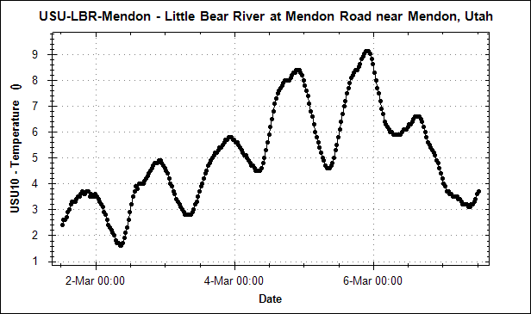
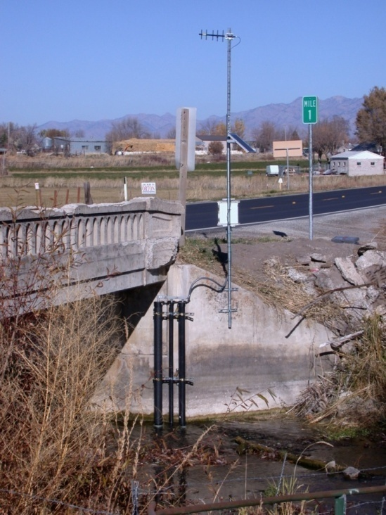

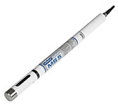
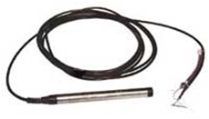

Data Models
Define the “entity” types within a domain
Values
Sites (where)
Methods (how)
Data Sources (who)

Slide 7
Data Models
Define the “attributes” of entities
Attributes Values
Site Name: Little Bear River near Wellsville
Site Code: USU-LBR-Wellsville
Latitude: 41.643457
Longitude: -111.917649
Elevation: 1365 m
State: Utah
County: Cache
Description: Attached to SR101 bridge.
Site Type: Stream
Entity = Site

Slide 8

Data Models
Define the relationships among entities
Variable and Method
Source
Values
Site
Water temperature values in degrees Celsius measured in the Little Bear River at Mendon Road using a Hydrolab MS5 multiparameter sonde by Utah State University

Slide 9
Data Models
Define the “business rules” for data
Observations are recorded at one and only one site
One or more variables are measured at a site
A site must have a name
A variable name must be chosen from a controlled vocabulary

Slide 10
What are the different types of data models?

Slide 11
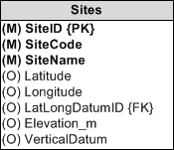
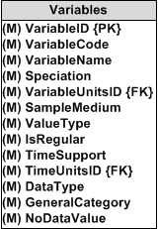
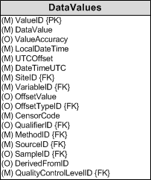
Types of Data Models
Relational data models – e.g., relational databases
1
1
*
*

Slide 12
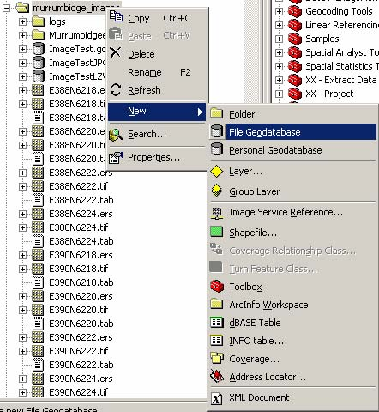
Types of Data Models
File based data models
ESRI File Geodatabase
NetCDF
Structured file or set of files that store data

Slide 13
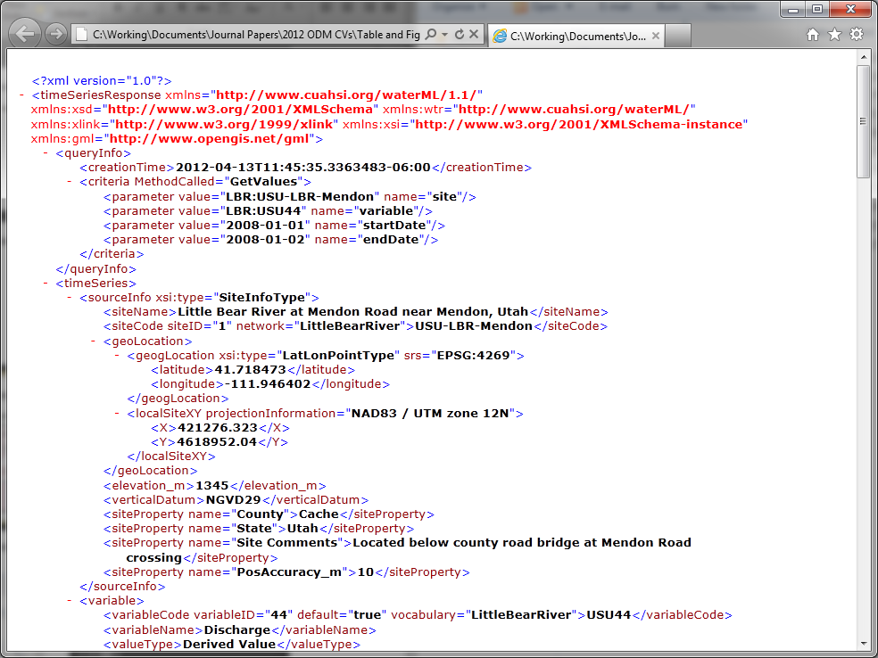
Types of Data Models
Extensible Markup Language (XML) schemas

Slide 14
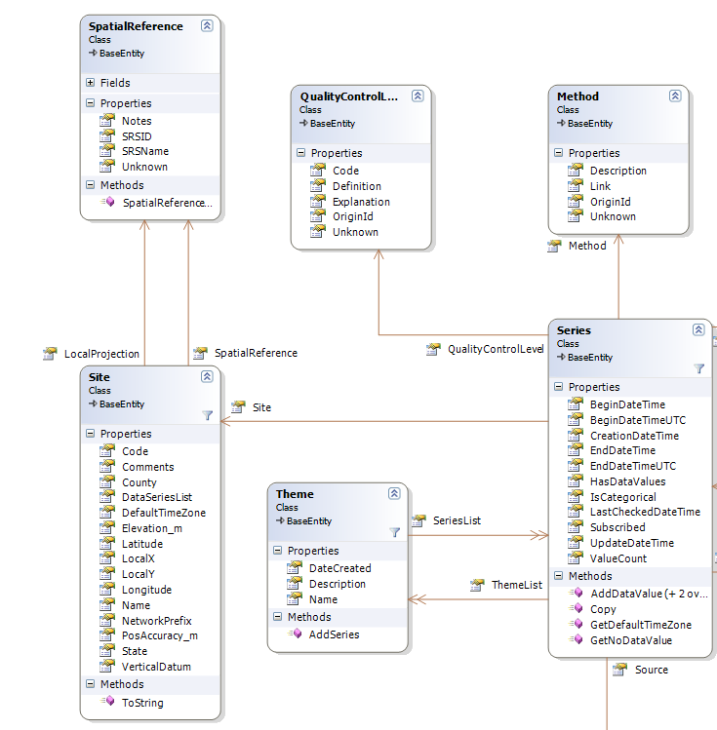
Object Model
Types of Data Models
Class/Object
Properties
Methods

Slide 15
What are some data models commonly used in Hydrology?

Slide 16
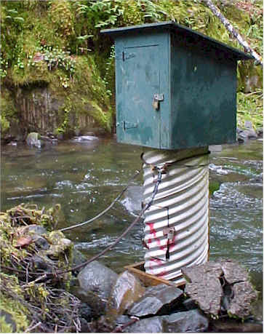
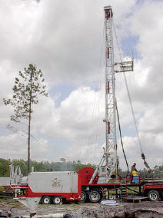
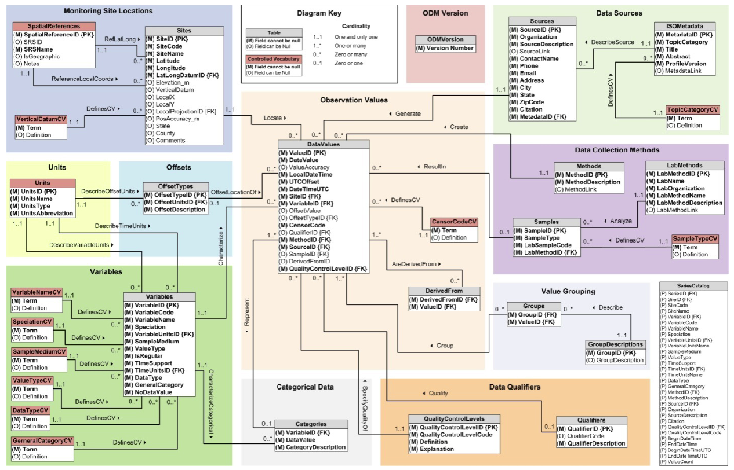
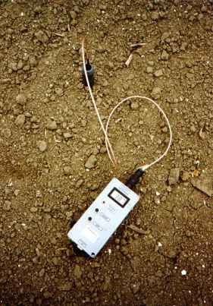
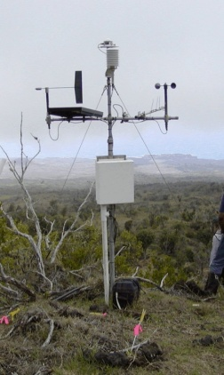
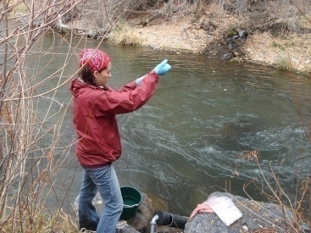
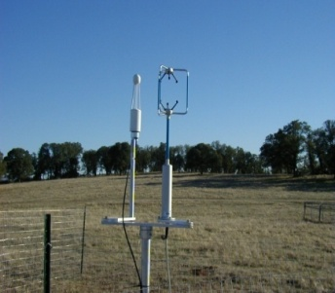
Observations Data Model (ODM)
Streamflow
Groundwater
levels
Precipitation
& Climate
Soil
moisture
data
Water Quality
Flux tower data
A relational database at the single observation level
Metadata for unambiguous interpretation
Traceable heritage from raw measurements to usable information
Promote syntactic and semantic consistency
Cross dimension retrieval and analysis
Horsburgh, J. S., D. G. Tarboton, D. R. Maidment, and I. Zaslavsky (2008), A relational model for environmental and water resources data, Water Resources Research, 44, W05406, doi:10.1029/2007WR006392.

Slide 17
What are the basic attributes to be associated with each single data value and how can these best be organized?
DateTime
Interval (support)
“When”
Time, T
Units
Accuracy
Censoring
Qualifying comments
t
A data value
v_{i} (s,t)
Variable
Method
Quality Control Level
Sample Medium
Value Type
Data Type
Source/Organization
s
“Where”
v_{i}
Space, S
Location
Feature of interest
“What”
Variables, V

Slide 18
Data Series – A Time Series of Hydrologic Observations
Time
Defined by unique combinations of:
Site
Variable
Method
Source
Quality Control Level
End Date Time, t₂
Count, C
Begin Date Time, t₁
Site, S_{j}
Space
Variable, V_{i}
Variables
There are C measurements of Variable V_{i} at Site S_{j} from time t₁ to time t₂

Slide 19
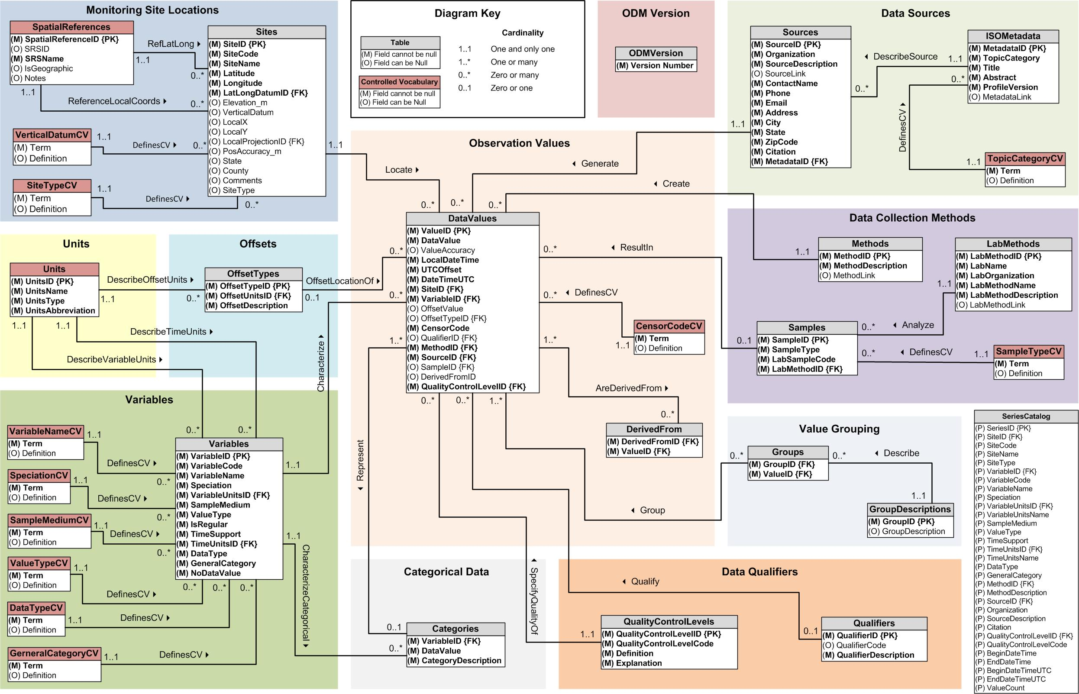
ODM 1.1.1
Sites
(where)
Sources
(who)
Methods
(how)
Values +
(when)
Quality Control Levels
Variables
(what)

Slide 20
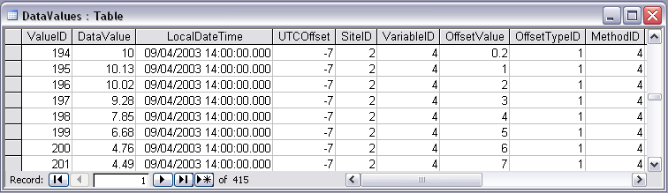
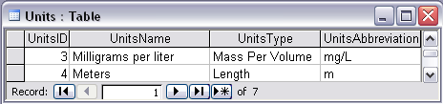
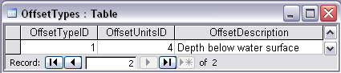
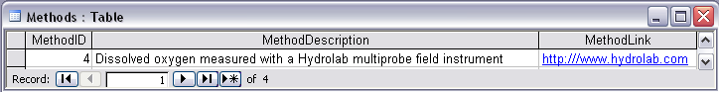
ODM Example: Water Quality from a Profile in a Lake
Notes:
Water Chemistry From a Lake Profile
Concepts:
Grouped observations (all observations in one reservoir profile)
Observations made using an offset (observations made at multiple depths below the surface of a reservoir)
Observations made using a specific method (observations made using a particular field instrument)
Relationships:
Relationship between Values table and the Variables table on VariableID
Relationship between Values table and OffestTypes table on OffsetTypeID
Relationship between Values table and Methods table on MethodID
Relationship between Variables table and Units table on UnitID
Relationship between GroupDescriptions table and Groups table on GroupID
Relationship between OffsetTypes table and Units table on UnitID and OffsetUnitID

Slide 21
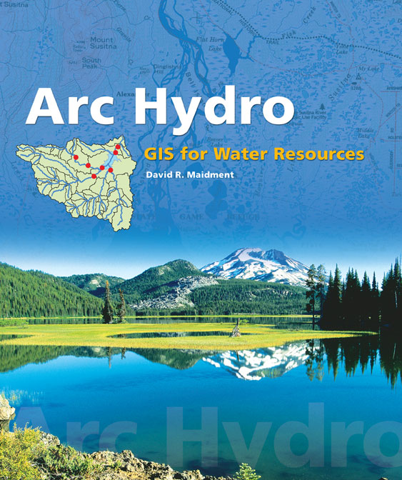
Arc Hydro: GIS for Water Resources
Published in 2002, now in revision for Arc Hydro II
Arc Hydro
An ArcGIS data model for water resources
Arc Hydro toolset for implementation
Framework for linking hydrologic simulation models
The Arc Hydro data model and
application tools are in the public
domain
Notes:
Notes:
Industrial partners: ESRI, Danish Hydraulic Institute, Camp,Dresser and McKee, Dodson and Associates
Government partners:
Federal: EPA, USGS, Corps of Engineers (Hydrologic Engineering Center)
State: Texas Natural Resource Conservation Commission, Texas Water Development Board
Local: Lower Colorado River Authority, City of Austin, Dept of Watershed Protection
Academic Partners: University of Texas, Brigham Young University, Utah State University

Slide 22
Arc Hydro Framework Input Data
Watersheds
Waterbody
Streams
Hydro Points
Notes:
The Arc Hydro Framework is a simplified version of the full Arc Hydro data model designed for an entry level user who just wants to put together a basic data set for streams, watersheds, waterbodies and hydro points like stream gages and water quality monitoring points

Slide 23
Arc Hydro Framework
Data Model
Notes:
The Arc Hydro framework is built on a Hydro Network made up of HydroEdges (stream lines) and HydroJunctions (points of interest on the lines). The watersheds, waterbodies and hydropoints are connected to the hydronetwork using relationships with the hydro junctions (blue lines in the diagram).

Slide 24
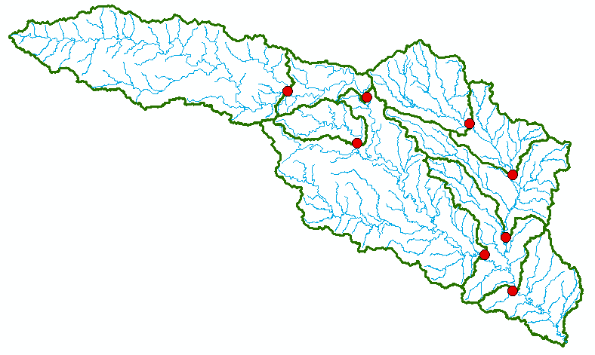
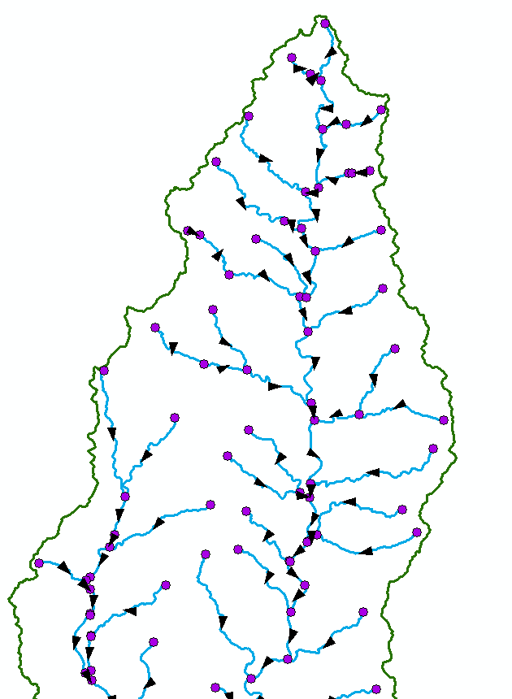
What Can I do with ArcHydro?
ArcHydro defines flow lines and junctions and encodes flow directions
ArcHydro encodes relationships among watersheds, streams, and junctions
Establishes hydrologic connectivity between polygon catchments (polygons), stream reaches (lines), and junctions (points)

Slide 25
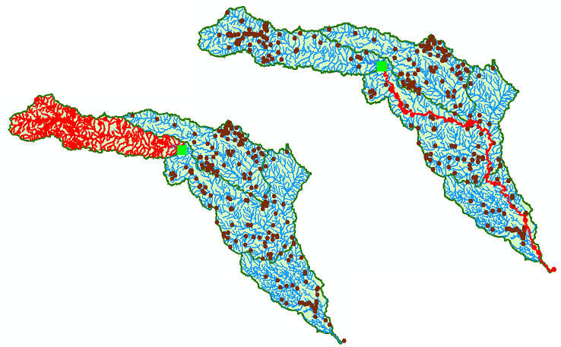
What Can I Do with ArcHydro?
Network Tracing
Select all streams above a point
Select the downstream path for a point

Slide 26


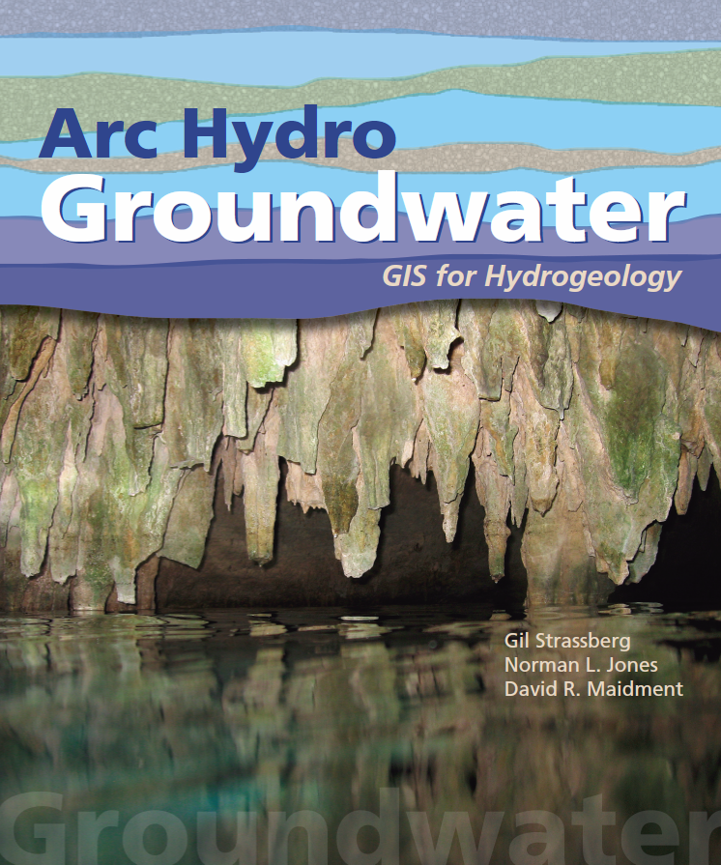
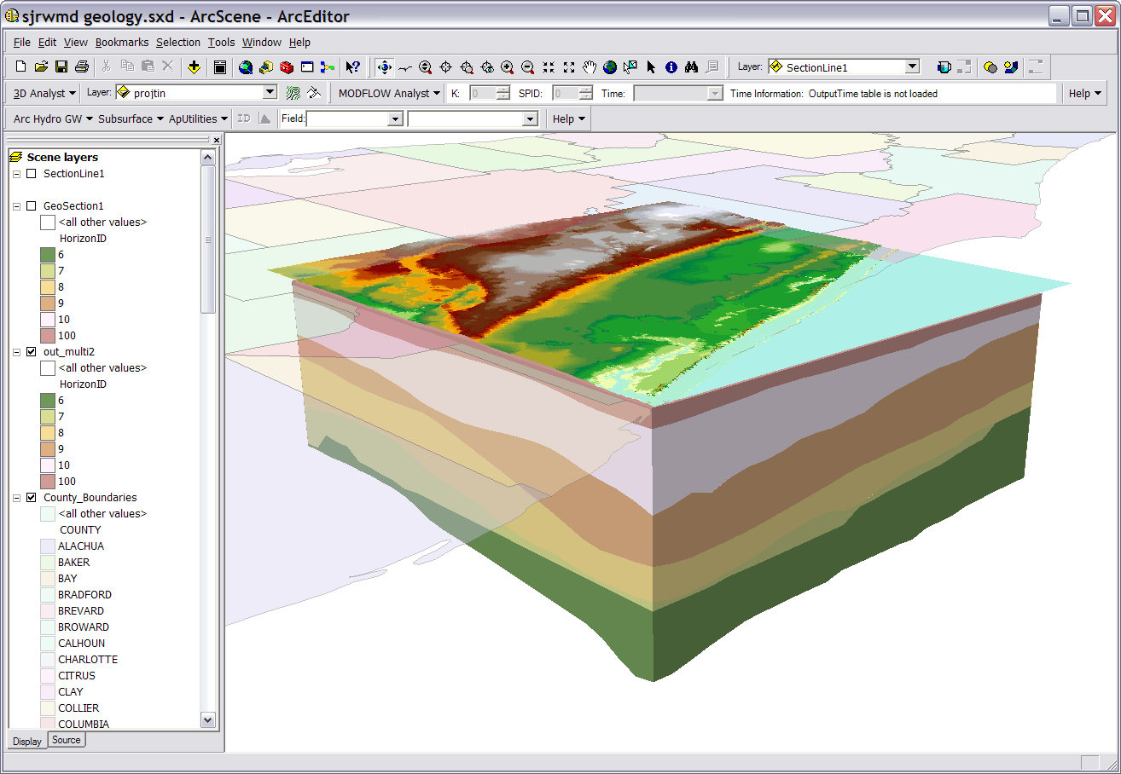
Arc Hydro Groundwater
Data model and tools for managing groundwater data in ArcGIS
Notes:
Notes:
Industrial partners: ESRI, Danish Hydraulic Institute, Camp,Dresser and McKee, Dodson and Associates
Government partners:
Federal: EPA, USGS, Corps of Engineers (Hydrologic Engineering Center)
State: Texas Natural Resource Conservation Commission, Texas Water Development Board
Local: Lower Colorado River Authority, City of Austin, Dept of Watershed Protection
Academic Partners: University of Texas, Brigham Young University, Utah State University

Slide 27
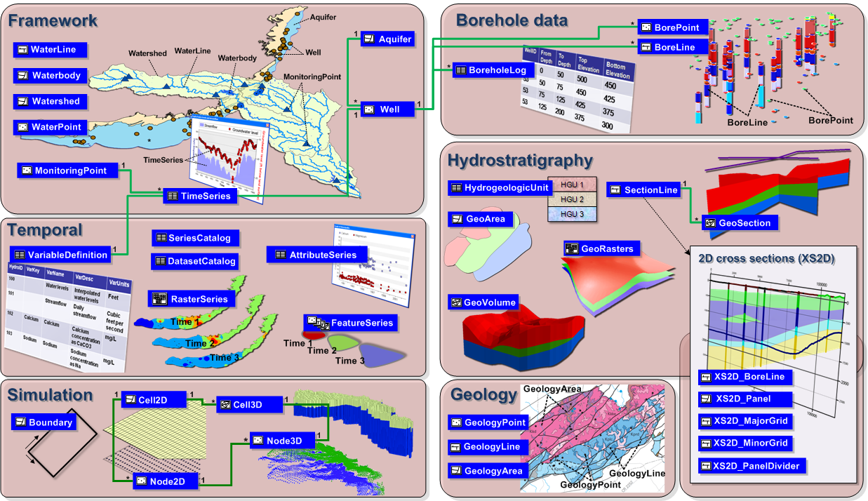
Arc Hydro GW Data Model
Notes:
This is an overview diagram of the AHGW data model.
You can review the different components, talk about what each component is for:
Framework – includes hydrography, monitoring points, wells, aquifers, tables for managing time series (the framework includes a simplified temporal component). – with the framework you can get started on most water resources projects.
Borehole data – description of vertical information recorded along boreholes (hydrostratigraphy, well construction).
Geology – representation of data from geologic maps.
Hydrostratigraphy – building 2D and 3D hydrogeologic models including surfaces, cross sections, volumes.
Temporal – dealing with time varying data – plots, tracks, animations.
Simulation – integration with groundwater simulation models, especially MODFLOW.

Slide 28
NetCDF
A platform independent format for representing multi-dimensional, array-orientated scientific data
Continuous space-time data model
Both time and space are varying
Especially useful for time-varying grids
Time varying precipitation fields (e.g., radar rainfall data)
Used extensively in the weather and climate domains

Slide 29
Multidimensional Data
Time = 3
Time = 2
Time = 1
http://www.unidata.ucar.edu

Slide 30
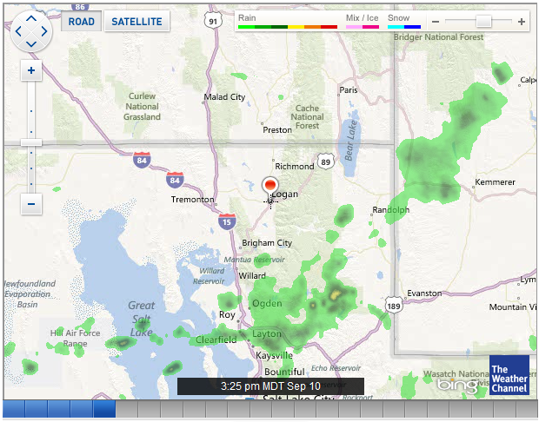
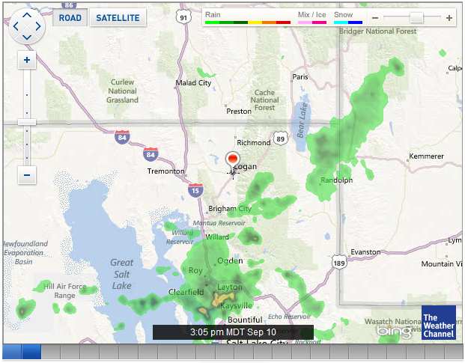
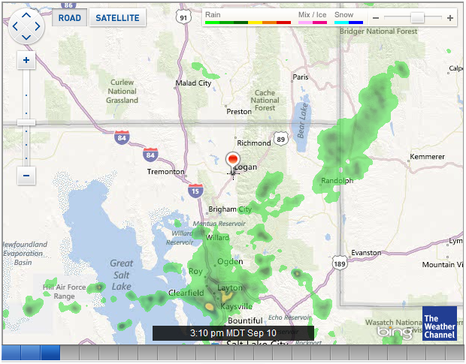
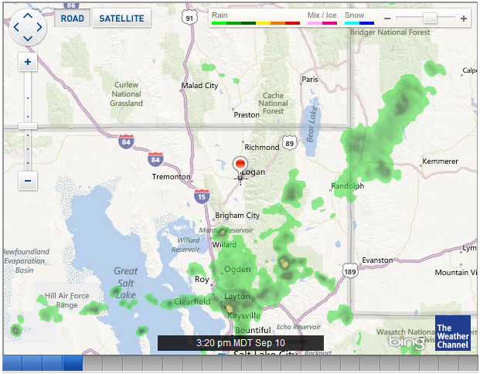
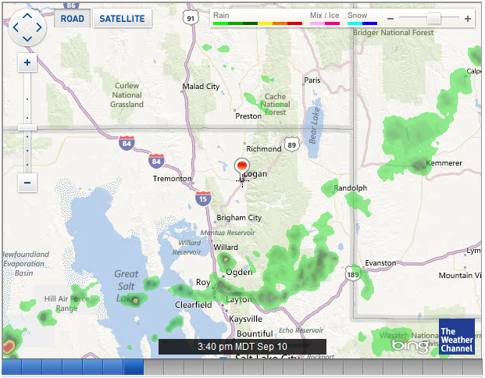
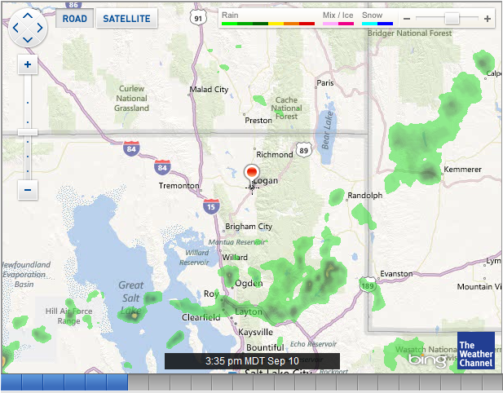
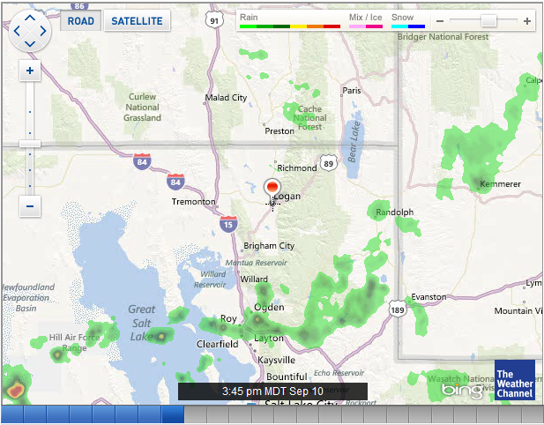
Multidimensional Data – Space and Time

Slide 31
Data Modeling
Goal – make sure all data objects required by a database are completely and accurately represented
Data model design – the blueprint for creating a physical implementation of a database

Slide 32
Data Modeling Terms
Entity – a class of real world objects having common attributes (e.g., sites, variables, methods).
Attribute – A characteristic or property of an entity (site name, latitude, longitude)
Relationship – an association between two or more entities
Cardinality – the number of entities on either end of a relationship (one-to-one, one-to-many, many-to-many, etc.)

Slide 33
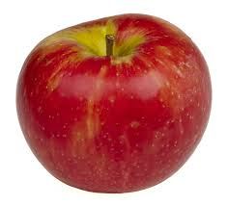
Data Modeling Exercise
Consider:
What is the “entity”?
What are the “attributes” of the entity?

Slide 34
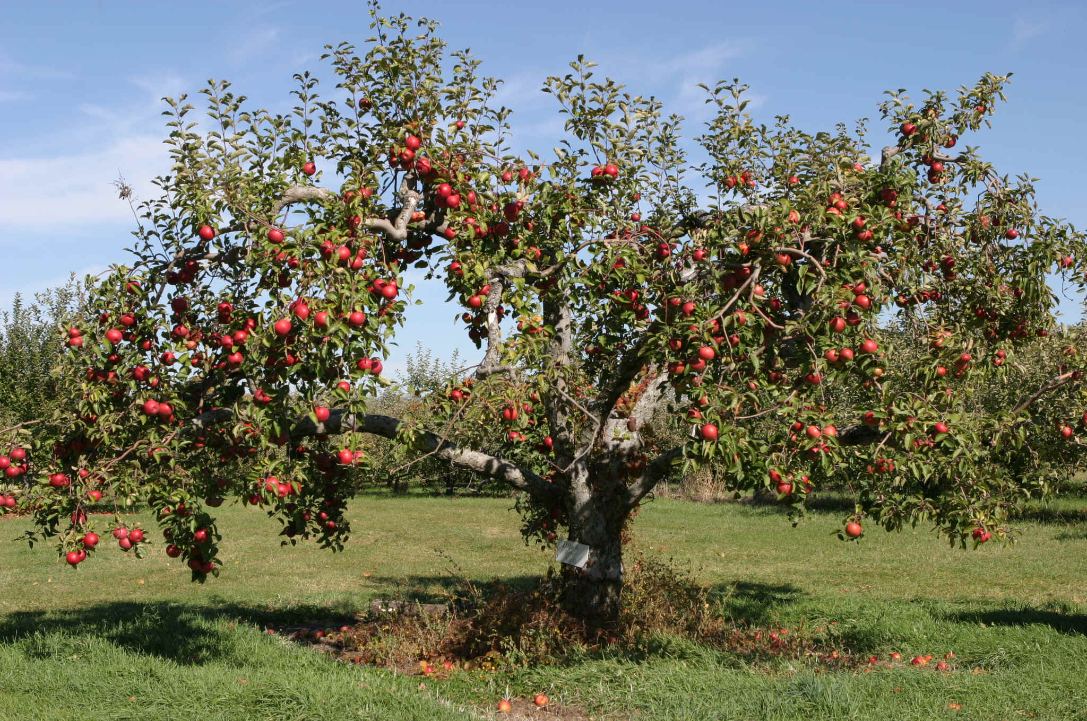
Data Modeling Exercise
What is the entity?
What are the attributes?

Slide 35
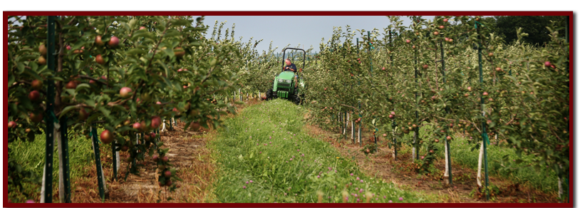
Data Modeling Exercise
What is the entity?
What are the attributes?

Slide 36
Data Modeling Exercise
What are the relationships?
Grows In
Apple
Apple Tree
Orchard
Grows On

Slide 37
Data Modeling Exercise
What are the relationships?
Grows In
Apple
Apple Tree
Orchard
Grows On
What about the business rules?

Slide 38
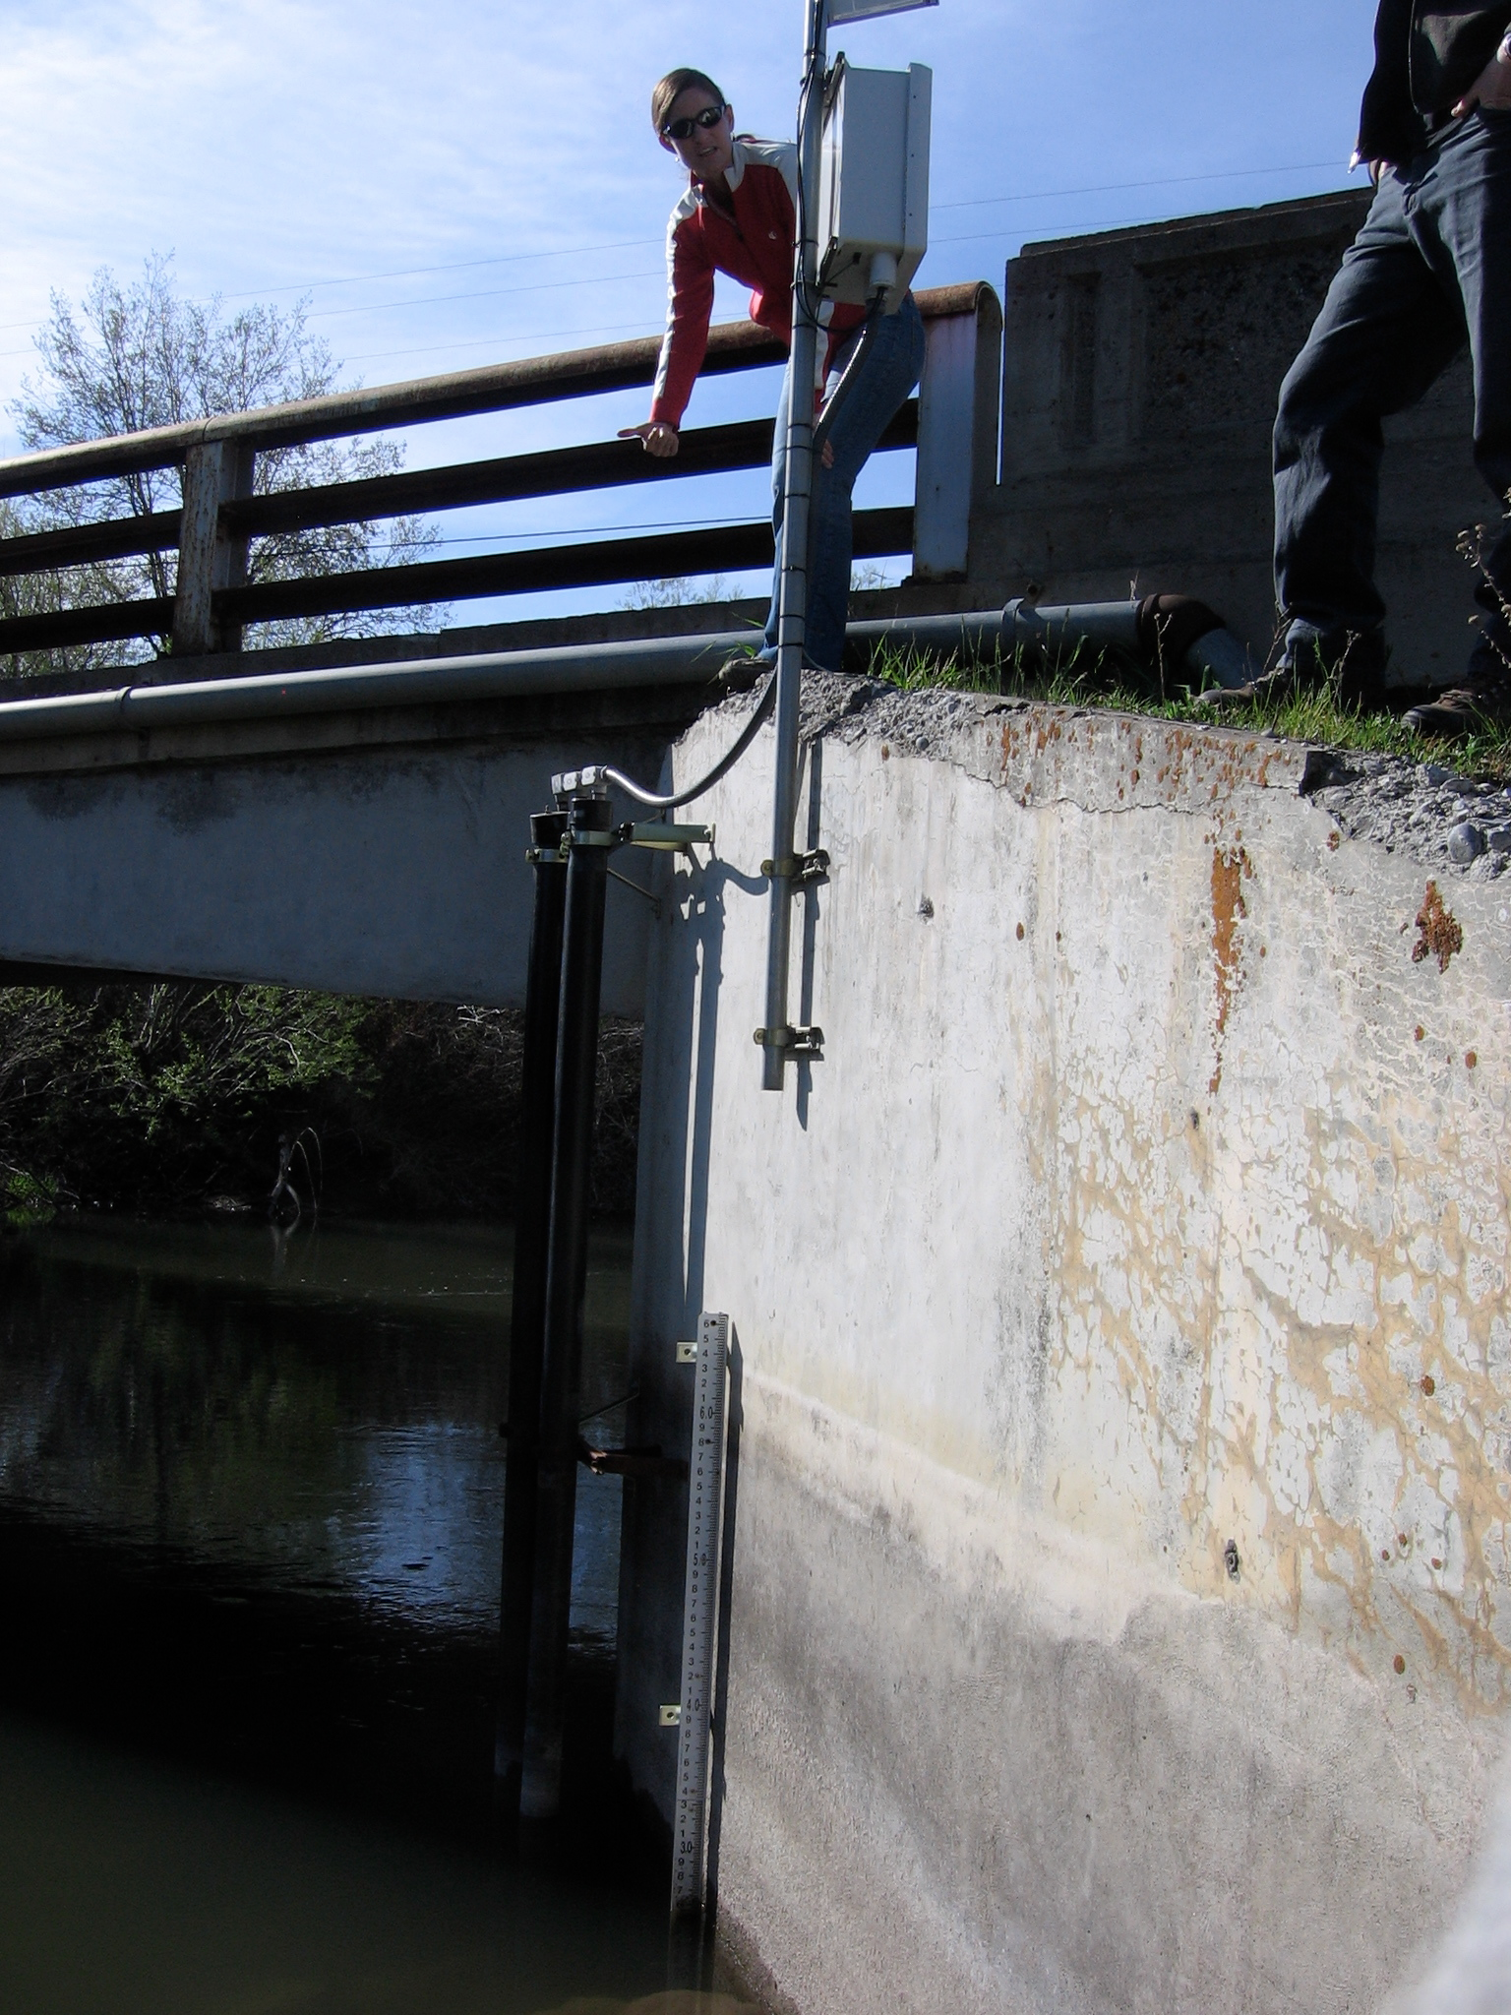
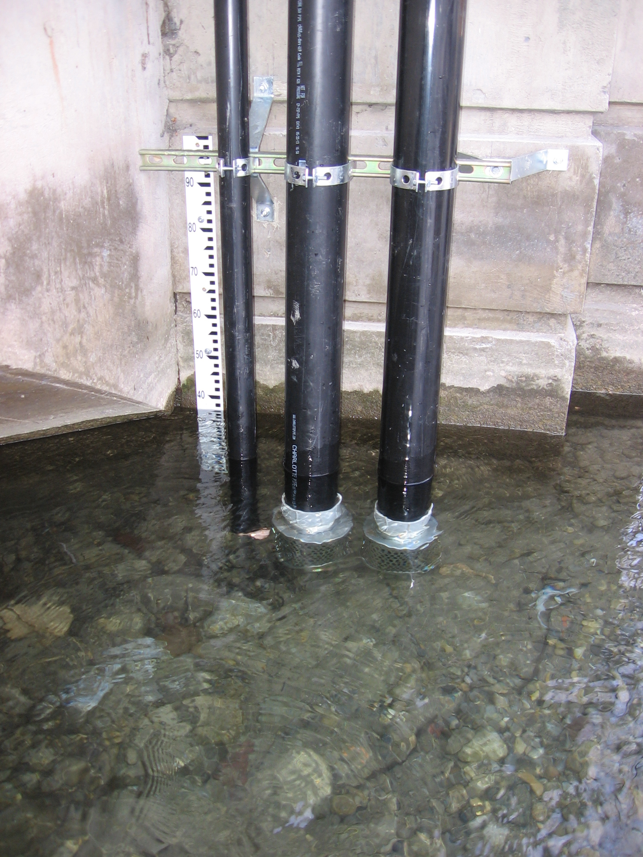
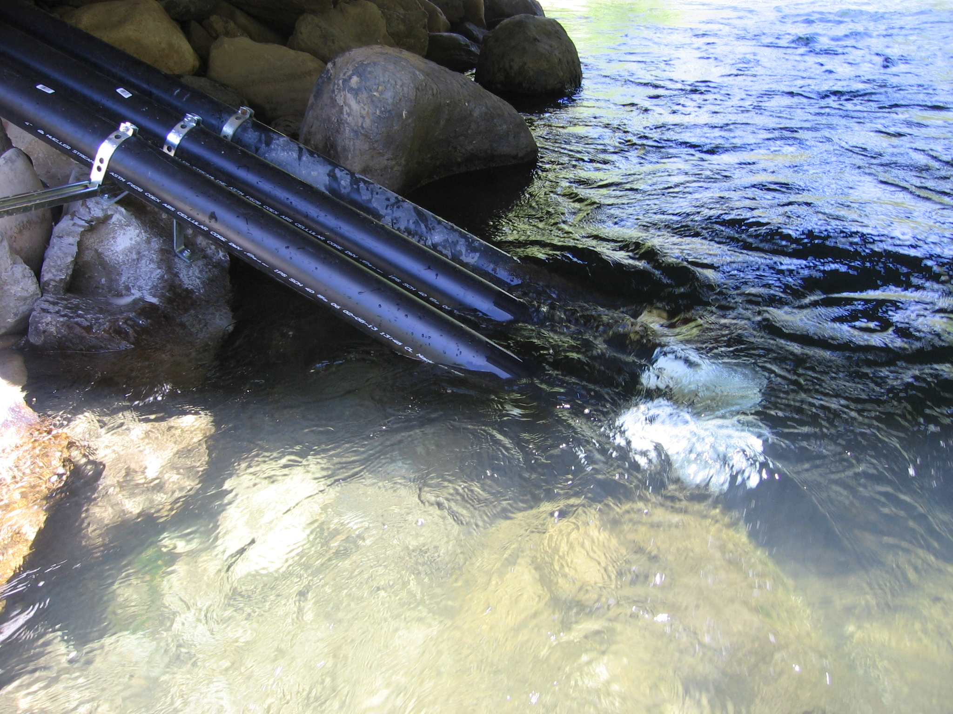
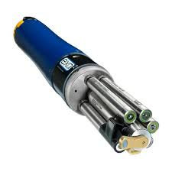
Assignment 3 Data
Multiple Monitoring Sites
1 or More Time Series Per Sensor
3 Different Watersheds
Multiple Sensors at Each Site

Slide 39
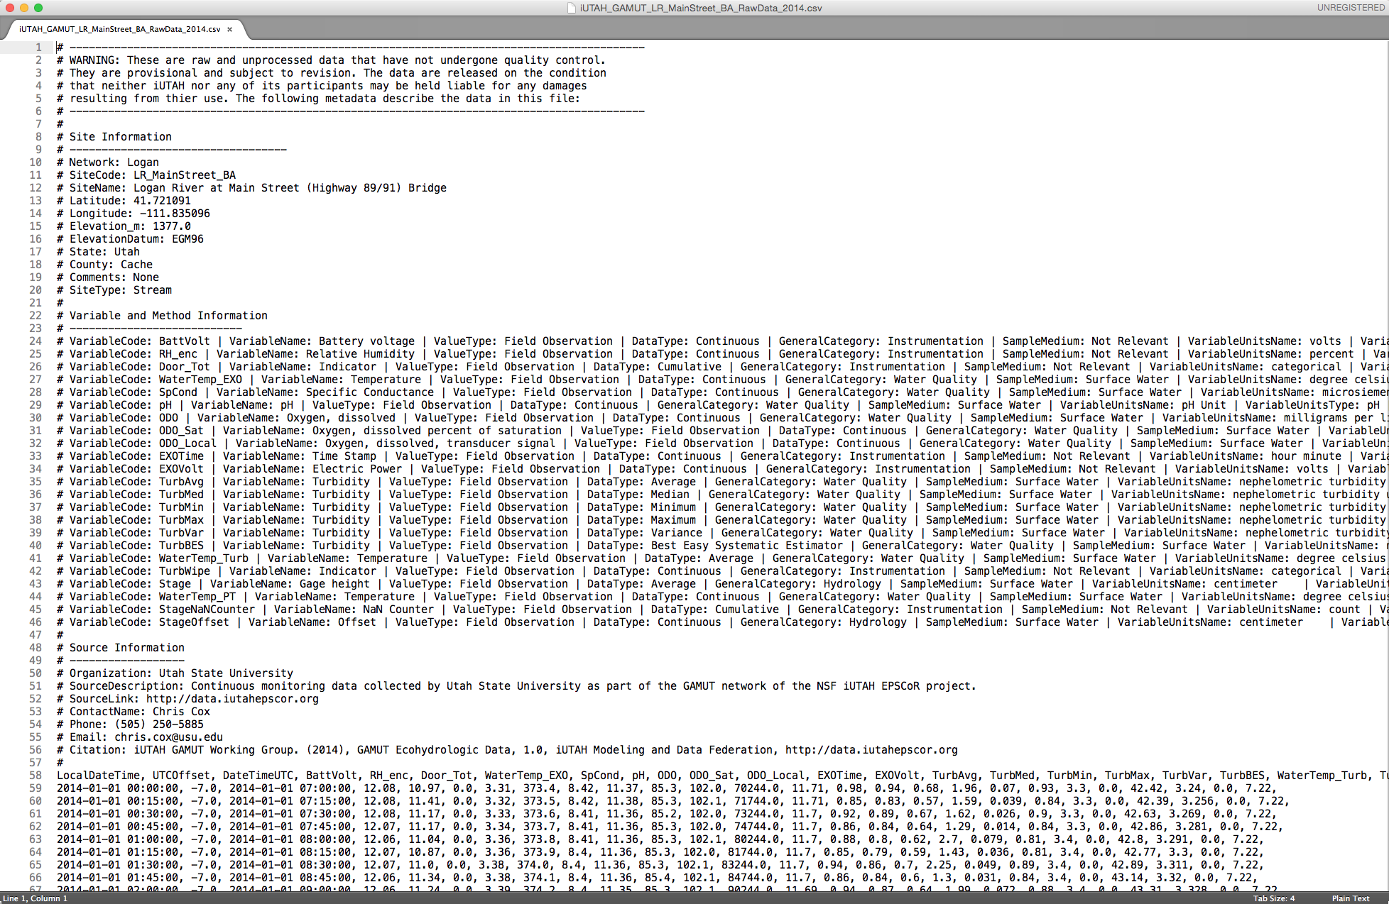
Assignment 3 Data
Site Information
Variable and Method Information
Source Information
Data Table

Slide 40
Assignment 3
A group of researchers recently deployed several instruments to continuously monitor streamflow and water quality at multiple monitoring sites in 3 watersheds located in northern Utah. The instruments report measurements in numerous datalogger data files that the researcher must now regularly retrieve, organize, quality-control/quality-check, aggregate, and manipulate before they can perform further analysis.
Design a logical data model to represent the data and its associated metadata
Use MySQL Workbench to create an entity relationship diagram of your data model

Slide 41
Data Model Design
Our focus – relational data model design
Three stages:
Conceptual data model
Logical data model
Physical data model

Slide 42
Conceptual Data Model (AKA – The Information Model)
High-level description of the data domain
Does not constrain how that description is mapped to an actual implementation in software
There may be many mappings
Relational database
Object model
XML schema, etc.

Slide 43
Apple/Tree/Orchard Conceptual Model
Grows In
Apple
Apple Tree
Orchard
Grows On

Slide 44
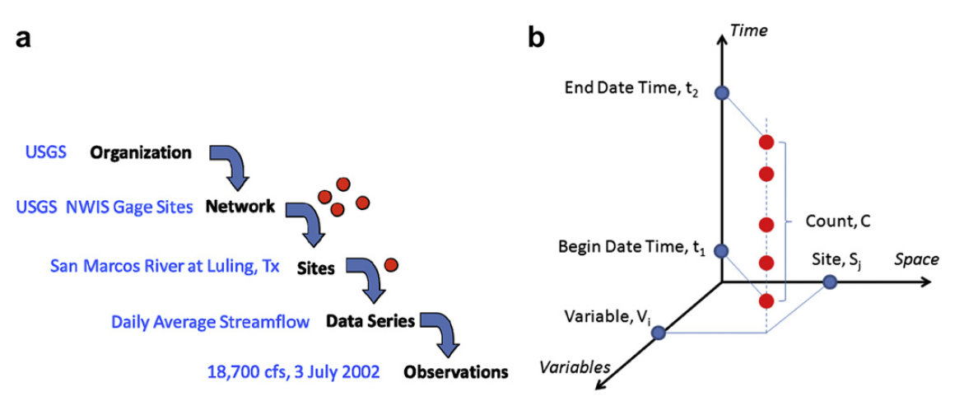
Hydrologic Time Series
An organization operates a network of monitoring sites. At each site they collect data for a number of time series, and each time series contains a set of observations

Slide 45
Conceptual Data Model
Defines scope of the domain
Defines and organizes data requirements
Defines entities and relationships among them
Entities
Site
1
TimeSeries
*
1
Observations
Relationships
*

Slide 46
Defining Entities and Relationships
Instead of beginning with this:
Sometimes its easier to write statements:
Many TimeSeries are measured at a Site.
Each TimeSeries contains one or more Observations.
The nouns become entities and the verbs become relationships.
Site
TimeSeries
1
*
1
Observations
*

Slide 47
Considerations in Modeling Data
What is the information/data domain that you are modeling?
Is there an existing data model that will work?
What are the 20 queries that you want to do?
e.g., “Give me simultaneous observations of turbidity and TSS collected during the spring snowmelt period so I can develop a regression in R.”
What software do you want (have) to use?
How do you want to share the data?

Slide 48
Advantages of Formal Data Models
Provide a high degree of structure to data
Generally implemented in software that has robust querying, manipulation, and visualization capabilities (e.g., RDBMS or GIS)
Facilitate software development
Can help in capturing the semantics of data

Slide 49
Disadvantages
Can be stiff and difficult to change
Difficult to anticipate needs in the design stages
Can be incompatible across organizations
Can become complex

Slide 50
Summary (1)
A data model provides a definition of a formal structure for data
There are several flavors of data models, each with different strengths, weaknesses, and appropriate uses
Data models can facilitate software development

Slide 51
Summary (2)
Common data models used in hydrology
The CUAHSI Observations Data Model (ODM) provides an organizational structure for hydrologic time series data
Arc Hydro is a geographic data model for surface hydrologic features
ArcHydro Groundwater adds subsurface hydrologic features, geology, borehole data, and hydrostratigraphy
NetCDF combines both geospatial and temporal domains into a continuous space-time data model

Slide 52
References and Credits
Horsburgh, J.S., D.G. Tarboton (2012). CUAHSI Community Observations Data Model (ODM) Version 1.1.1 Design Specifications, CUAHSI, Washington, D.C, http://www.codeplex.com/Download?ProjectName=HydroServer&DownloadId=349176
Horsburgh, J. S., D. G. Tarboton, D. R. Maidment, and I. Zaslavsky (2008), A relational model for environmental and water resources data, Water Resources Research, 44, W05406, http://dx.doi.org/10.1029/2007WR006392.
Maidment, D.R. (ed.) (2002). Arc Hydro GIS for Water Resources, ESRI Press, Redlands, CA, 203 p.
Strassberg, G., N.L. Jones, D.R. Maidment (2011). Arc Hydro Groundwater GIS for Hydrogeology, ESRI Press, Redlands, CA, 160 p.
Credits:
Arc Hydro slides used with permission from David Maidment, University of Texas at Austin.
ArcHydro Groundwater slides used with permission from Norm Jones, Brigham Young University/Aquaveo.

Slide 53
Exercise: Conceptual Data Model
Multiple Monitoring Sites
1 or More Time Series Per Sensor
3 Different Watersheds
Multiple Sensors at Each Site

